Slide 1
“Black Diamonds” (1949) Ôta Ryôhaku
黒ダイヤ
太田良博

Slide 2
Timeline
1500s: Ryûkyû Kingdom (independent, tribute to Japan and China)
1609: Satsuma invasion
1868: emergence of nation-state of Japan
1879: Ryûkyû abolished, Okinawa incorporated as prefecture
1894-5: Sino-Japanese War
Taiwan colonized
1904-5: Russo-Japanese War
Korea colonized in 1910

Slide 3
Timeline continued
1931-1945: further expansion, particularly in China, then SEAsia
April 1-June 22: Battle of Okinawa
August 6, 1945: atomic bombing of Hiroshima
August 9, 1945: atomic bombing of Nagasaki
August 15, 1945: Japan’s surrender
U.S. Occupation of Japan: 1945-1952
U.S. Occupation of Okinawa: 1945-1972

Slide 4
Battle of Okinawa
April 1-June 22
Uchinaa ikusa, Operation Iceberg, typhoon of steel
Half of prewar population killed, island decimated
Foreign and “friendly” enemy
Imperial education (indoctrination) and group suicide
Execution of “spies”
Textbook controversy, voluntary vs. coerced, Ôe Kenzaburô
Cornerstone of Peace, 1995

Slide 5
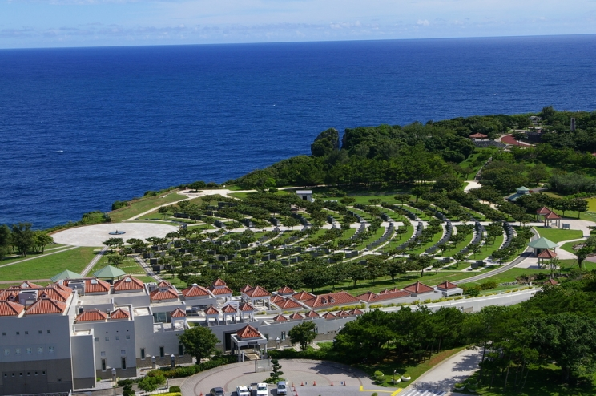
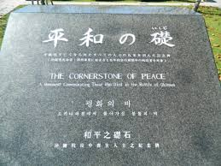
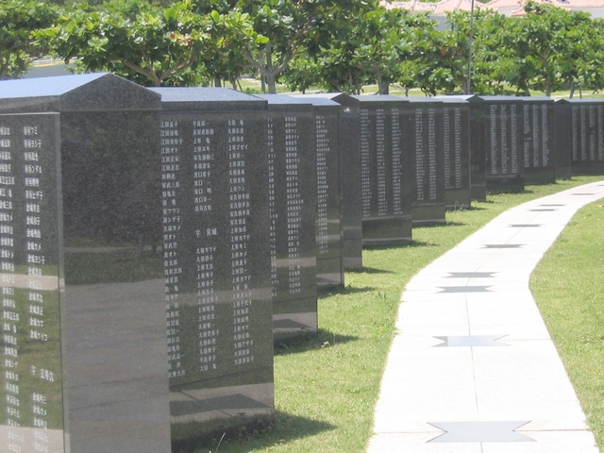
Cornerstone of Peace 1995

Slide 6
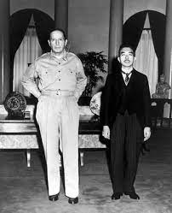
Hirohito and Macarthur

Slide 7
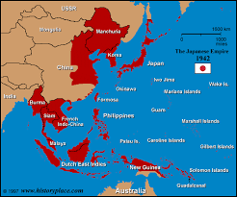
Japanese Empire at its Peak

Slide 8
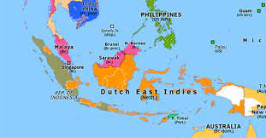
Map of Indonesia

Slide 9
Keywords
Black diamonds
I-fiction
Elegy
Portugese, Dutch, Japanese, British/Allies
Japanese Empire, 1942-1945 (Indonesia)
Independence for Indonesia, 1949
Postwar US/Japan, infantilization
Appropriation vs. inclusion, coevalness

Slide 10
Discussion Question
Why is “Black Diamonds” considered the emblematic work of postwar Okinawan fiction?
What is the problem with reading “Black Diamonds” as it is understood in Q1?
What is a solution to the problem of reading ”Black Diamonds” as it has been traditionally?
What is a pitfall of the solution as it is understood in Q3? Is there a responsible way to read “Black Diamonds”? What is it?

